Slide 1


Optimizing Big Data for Social Buzz's IPO

Slide 2


Today's agenda
Project recap
Problem
The Analytics team
Process
Insights
Summary

Slide 3

Social Buzz is fast growing technology unicorn that needs to adapt quickly to its global scale.
Accenture has begun its 3-month POC on these tasks:
An audit of social media buzz big data practice.
Recommendations for a successful IPO.
Analysis to find social media buzz top 5 most popular categories
Project Recap

Slide 4

Problem
Over 10000 posts per day
36,500,000 pieces of content per year
But how to capitalize on it when there’s so much?
Analysis to find Social Buzz’s Top 5 most popular categories of content.

Slide 5



Luheto Vunda Data Analyst
The Analytics team
Marcus Rompton Senior Principal.
Andrew Fleming Chief Technical Architect

Slide 6
Process
1
Data Understanding.
2
Data Cleaning.
3
Data Modeling.
4
Data Analysis.
5
Uncovering Insights.

Slide 7

Insights
There are 16 unique categories on Social Buzz, the top 5 popular ones being:
animals
science
healthy eating
technology
food
With each most popular category getting the following reactions per month:
Animals -1897
Science - 1796
healthy eating - 1717
food -1699
Technology - 1698
The month of May has the most reactions on the platform with a tracking of 2138 .

Slide 8
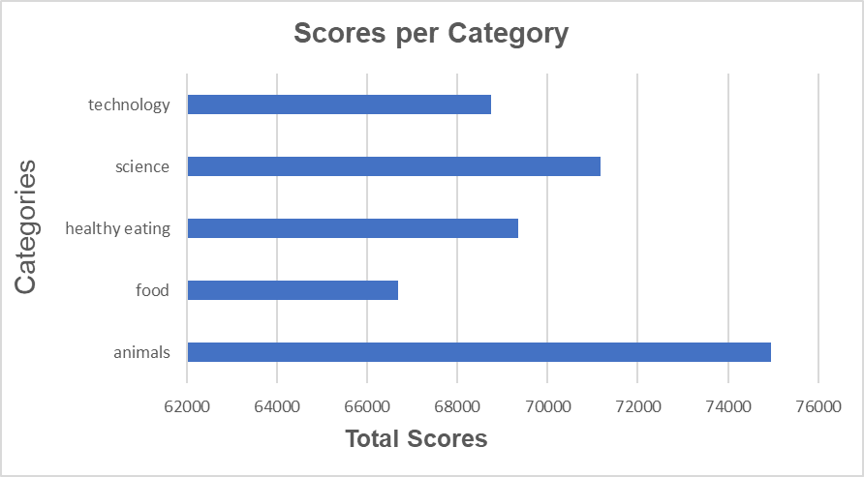

Slide 9
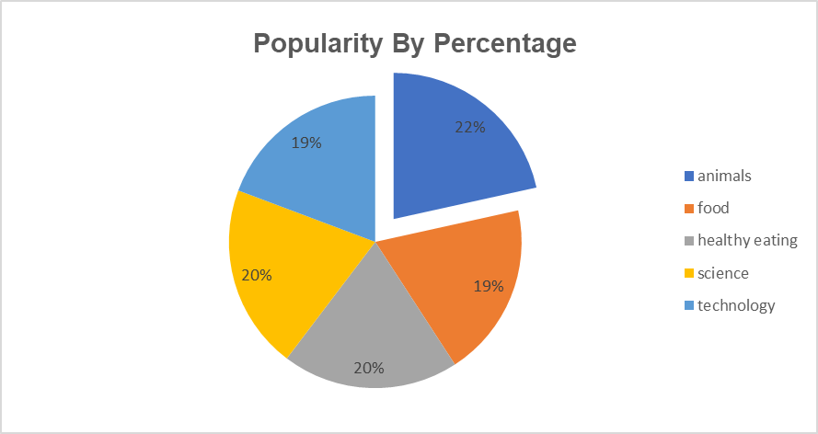

Slide 10

ANALYSIS
Animals and Science are the 2 most popular content, showing that people most enjoy “real-life’ and ‘factual’ content on the platform
INSIGHT
Food is the common theme with the top 5 categories with “Eating healthy” ranking the highest. This may give an indication to the audience within your user base. You can use this information to create a campaign and work with healthy eating brands to boost engagement.
NEXT STEPS
This ad-hoc analysis is insightful, but its time to take this analysis into large scale production for real-time understanding of your business. We can show you.
Summary

Slide 11
Thank you!
ANY QUESTIONS?

